Slide 1
Scrum Methodology

Slide 2
What is Scrum?
Scrum is a framework within which people can address complex adaptive problems, while productively and creatively delivering products of the highest possible value.
It is framework that helps people, teams and organizations generate value through adaptive solutions for complex problems.
Scrum was co-created by Ken Schwaber and Jeff Sutherland
Scrum requires a Scrum Master to foster an environment where:
A Product Owner orders the work for a complex problem into a Product Backlog.
The Scrum Team turns a selection of the work into an Increment of value during a Sprint.
The Scrum Team and its stakeholders inspect the results and adjust for the next Sprint.

Slide 3
Scrum Roles and Responsibilities
Scrum is comprised of three roles and responsibilities:
Scrum Master: Responsible for setting up the team, removing obstacles to progress, and the sprint meeting
Scrum Team: Manages and organises the work required to complete the sprint or cycle
Product Owner: Creates the product backlog, prioritises the backlog, and is responsible for the delivery of functionality at every iteration

Slide 4
Scrum Roles and Responsibilities

Slide 5
Scrum Events
Sprint Planning
Product Backlog
Sprint
Sprint Backlog
Daily Scrum Meet
Daily 15 minute status meeting
Business Conditions
Team Structure and Capabilities
30 Day plan
Sprint burndown charts
Prioritisation of the tasks and decisions
Tasks discussion and impedimens
Decision-Making
Sprint Review Meeting
Review meeting
Informal set-up as and when required
Sprint Retrospective Meet
Process Improvement
Scrum Master responsibility

Slide 6
Sprint and Sprint Planning
Sprints are the heartbeat of Scrum, where ideas are turned into value.
They are fixed length events of one month or less to create consistency.
All the work necessary to achieve the Product Goal, including Sprint Planning, Daily Scrums, Sprint Review, and Sprint Retrospective, happen within Sprints.
Sprint Planning initiates the Sprint by laying out the work to be performed for the Sprint. This resulting plan is created by the collaborative work of the entire Scrum Team.
The Product Owner ensures that attendees are prepared to discuss the most important Product Backlog items and how they map to the Product Goal. The Scrum Team may also invite other people to attend Sprint Planning to provide advice.

Slide 7
Daily Scrum Meeting
Daily Scrum is to inspect progress toward the Sprint Goal and adapt the Sprint Backlog as necessary, adjusting the upcoming planned work.
The Daily Scrum is a 15-minute event for the Developers of the Scrum Team. To reduce complexity, it is held at the same time and place every working day of the Sprint. If the Product Owner or Scrum Master are actively working on items in the Sprint Backlog, they participate as Developers.
The Developers can select whatever structure and techniques they want, as long as their Daily Scrum focuses on progress toward the Sprint Goal and produces an actionable plan for the next day of work. This creates focus and improves self-management.
Daily Scrums improve communications, identify impediments, promote quick decision-making, and consequently eliminate the need for other meetings.
The Daily Scrum is not the only time Developers are allowed to adjust their plan. They often meet throughout the day for more detailed discussions about adapting or re-planning the rest of the Sprint’s work.

Slide 8
Sprint Review Meeting
Sprint Review is to inspect the outcome of the Sprint and determine future adaptations.
The Scrum Team presents the results of their work to key stakeholders and progress toward the Product Goal is discussed.
During the event, the Scrum Team and stakeholders review what was accomplished in the Sprint and what has changed in their environment.
Based on this information, attendees collaborate on what to do next. The Product Backlog may also be adjusted to meet new opportunities.
Review of how the marketplace or potential use of the product might have changed what is the most valuable thing to do next; and,
Review of the timeline, budget, potential capabilities, and marketplace for the next anticipated releases of functionality and capability of the product.

Slide 9
Sprint Review Meeting
The Sprint Review includes the following elements:
Attendees include the Scrum Team and key stakeholders invited by the Product Owner
The Product Owner explains what Product Backlog items have been “Done” and what has not been “Done”
The Developers discuss what went well during the Sprint, what problems it ran into, and how those problems were solved
The Developers demonstrate the work that it has “Done” and answers questions about the Increment
The Product Owner discusses the Product Backlog as it stands. He or she projects likely target and delivery dates based on progress to date
The entire group collaborates on what to do next, so that the Sprint Review provides valuable input to subsequent Sprint Planning.

Slide 10
Sprint Retrospective
Purpose of the Sprint Retrospective is to plan ways to increase quality and effectiveness.
The Scrum Team inspects how the last Sprint went with regards to individuals, interactions, processes, tools, and their Definition of Done. Inspected elements often vary with the domain of work. Assumptions that led them astray are identified and their origins explored. The Scrum Team discusses what went well during the Sprint, what problems it encountered, and how those problems were (or were not) solved.
The Scrum Team identifies the most helpful changes to improve its effectiveness. The most impactful improvements are addressed as soon as possible. They may even be added to the Sprint Backlog for the next Sprint.
The Sprint Retrospective concludes the Sprint. It is timeboxed to a maximum of three hours for a one-month Sprint. For shorter Sprints, the event is usually shorter.

Slide 11
Sprint Retrospective
During the Sprint Retrospective, the team discusses:
What went well in the Sprint
What could be improved
What will we commit to improve in the next Sprint
The Scrum Master encourages the rest of the Scrum Team to improve its process and practices to make it more effective and enjoyable for the next Sprint. During each Sprint Retrospective, the Scrum Team plans ways to increase product quality by improving work processes or adapting the definition of “Done” if appropriate and not in conflict with product or organizational standards.
By the end of the Sprint Retrospective, the Scrum Team should have identified improvements that it will implement in the next Sprint. Implementing these improvements in the next Sprint is the adaptation to the inspection of the Scrum Team itself. Although improvements may be implemented at any time, the Sprint Retrospective provides a formal opportunity to focus on inspection and adaptation.

Slide 12
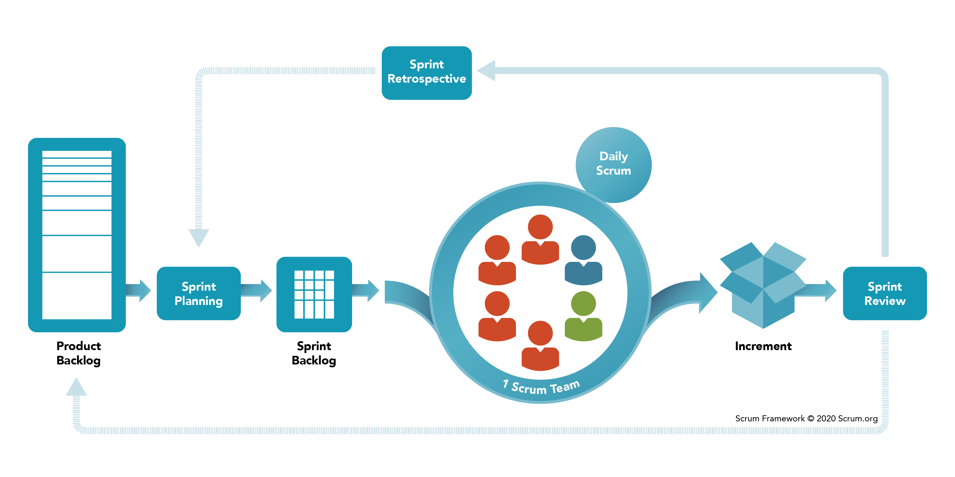
Scrum Framework

Slide 13
Working of Scrum
A Product Owner represents the interests of customers & users and creates an ordered list of work called a Product Backlog.
During Sprint Planning, the Developers that will carry out the work pull a subset from the top of the Product Backlog, decide how to carry out this work and create a plan of how to do so, called a Sprint Backlog.
The Developers have a time-boxed period called a Sprint of less than 1 month to complete the work.
The Developers meet each day at a Daily Scrum to assess their progress and plan the next 24 hours.
During the Sprint, a Scrum Master keeps the team focused on its work and helps them overcome issues impeding progress.
At the end of the Sprint, the work will be Done, usable and ready to present to a stakeholder.
A Sprint Review is held where the Scrum Team and stakeholders inspect the Done work and decide what to do next based on the latest insights into the product.
The Sprint ends with a Sprint Retrospective where the Scrum Team plans ways to improve their ways of working.

Slide 14
Thank You

